Slide 1
Lecture 2
Pigeonhole Principle

Slide 2
Summary
Pigeonhole principle –simple form
Pigeonhole principle –strong form
Ramsey’s theorem

Slide 3
The Pigeonhole Principle
If m+1 pigeons are put into m pigeonholes, then at least one hole contains two or more pigeons.

Slide 4
Dirichlet Principle
Variously known as the Dirichlet Principle, the statement admits an equivalent formulation:
If n>m pigeons are put into m pigeonholes, there's a hole with more than one pigeon.

Slide 5
Formal Statement of Pigeonhole Principle
A more formal statement is also available:
Let |A| denote the number of elements in a finite set A. For two finite sets A and B, there exists a 1-1 correspondence f: A→B iff |A|=|B|.

Slide 6
Generalized Pigeonhole Principle
If N objects are assigned to k places, then at least one place must be assigned at least ⎡N/k⎤ objects.
E.g., there are N=280 students in this class. There are k=52 weeks in the year.
  Therefore, there must be at least 1 week during which at least ⎡280/52⎤= ⎡5.38⎤=6 students in the class have a birthday.

Slide 7
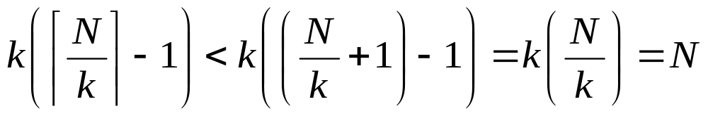
Proof of G.P.P.
By contradiction. Suppose every place has < ⎡N/k⎤ objects, thus ≤ ⎡N/k⎤−1.
Then the total number of objects is at most
So, there are less than N objects, which contradicts our assumption of N objects!

Slide 8
G.P.P. Example
Given: There are 280 students in the class. Without knowing anybody’s birthday, what is the largest value of n for which we can prove that at least n students must have been born in the same month?
Answer:
⎡280/12⎤ = ⎡23.3⎤ = 24

Slide 9
Application 1
Ex.1 There are several people in the room. Some are acquaintances, others are not. (Being acquainted is a symmetric non-reflexive relationship.) Show that some two people have the same number of acquaintances.
Hint. If there are N people in the room and each has a different number of acquaintances then one is bound to have N-1 and one 0 acquaintances. This is a contradiction.

Slide 10
Application 2
Ex. 2 Given m integers a₁, a₂, …,a_{m}, there exists integers k and l with 0 ≤ k < l ≤ m such that a_{k+1} + a_{k+2} + … + a_{l} is divisible by m.
Hint. Consider the m sums a₁, a₁+a₂, a₁+a₂+a₃, …, a₁+a₂+a₃+…+a_{m}. If any of these sums is divisible by m, then the conclusion holds. Thus suppose that each of the sums has a non-zero remainder when divided by m, and so a remainder equal to one of 1, 2, … m-1. Since there are m sums and only m-1 remainders , two of the sums have the same remainder when divided by m.

Slide 11
Exercises
From the integers 1, 2, …, 200, we choose 101 integers. Show that among the integers chosen there are two such that one of them is divisible by the other.
Hint: any integer can be written in the form 2^{k} × a, where k ≥ 0 and a is odd.

Slide 12
Pigeonhole Principle: Strong Form
Let q₁, q₂, …, q_{n} be positive integers. If
q₁+ q₂+ …+ q_{n}- n +1 objects are put into n boxes, then either the first box contains at least q₁ objects, or the second box contains at least q₂ object, ….., or the nth box contains at least q_{n} objects.

Slide 13
Proof for the Principle
Suppose that we distribute q₁+ q₂+ …+ q_{n}- n +1 objects among n boxes. If for each i = 1, 2, …, n the ith box contains fewer than q_{i} objects, then the total number of objects in all boxes does not exceed (q₁-1) + ( q₂-1) + …+ (q_{n}-1) = q₁+ q₂+ …+ q_{n}- n. Since this number is one less than the number of objects distributed, we conclude that for some i = 1, 2, …, n, the ith box contains at least q_{i} objects.

Slide 14
Other Statements
1. Let q₁ = q₂ = …= q_{n}=2. Then, q₁+ q₂+ …+ q_{n}- n +1 = n + 1. It corresponds to the simple form.
2. If each of q₁+ q₂+ …+ q_{n}- n +1 objects is assigned one of n colors, then there is an i such that there are (at least) q_{i} objects of the ith color.

Slide 15
Other Statements (cont’d)
3. Let q₁ = q₂ = …= q_{n}= r. The principle reads as follows: If n(r-1)+1 objects are put into n boxes, then at least one of the boxes contains r or more the objects.
4. If the average of n non-negative integers m₁, m₂, …,m_{n} is greater than r-1, then at least one of the integers is greater than or equal to r.

Slide 16
Other Statements (cont’d)
5. If the average of n non-negative integers m₁, m₂, …,m_{n} is less than r+1, then at least one of the integers is less than r+1.
6. If the average of n non-negative integers m₁, m₂, …,m_{n} is at least equal to r, then at least one of the integers satisfies m_{i} ≥ r.

Slide 17
Application Examples
A bag contains 100 apples, 100 bananas, 100 oranges and 100 pears. How many fruits should be taken out such that we can sure a dozen pieces of them are of the same kind?
A basket of fruit is being arranged out of apples, bananas, and oranges. What is the smallest number of pieces of fruits that should be put in the basket in order to guarantee that either there are at least 8 apples or at least 6 bananas or at least 9 oranges?

Slide 18
Exercise
There are 100 people at a party. Each people has an even number of acquaintances. Prove that there are three people at the party with the same number of acquaintances. (it is assumed that no one is acquainted with him or herself.)

Slide 19
A Theorem of Ramsey
K₆ → K₃, K₃, of 6 (or more) people, either there are 3, each pair of whom are acquainted, or there are three, each pair of whom are unacquainted.

Slide 20
Proof for K₆ → K₃, K₃
Suppose K₆ is colored with two colors (say, red and black) in anyway. Consider the 5 edges connecting to node p, by the strong form of pigeonhole principle, at least 3 of them are the same color (say, red). Then either △abc is black, or one of the edges in △abc (say edge bc) is red. Then △pbc is red.
p
a
c
b

Slide 21
Ramsey问题－2
而5个人的人群，可能出现既没有3个人彼此不认识，也没有3个人相互认识，如下图：
v1
v3
实线表示相互认识
虚线表示相互不认识
v2
v4
v5
所以r(3,3)≥6
>>

Slide 22
练习思考题
1、试证明9人中必有3个人相互认识或4个人相互不认识，两者必居其一。

Slide 23
六、Ramsey问题
自Ramsey在1928年提出了Ramsey数与相关理论70多年以来，至今求得的Ramsey数仅仅9个，它们是：
r(3,3)=6, r(3,4)=9, r(3,5)=14,
r(3,6)=18, r(3,7)=23, r(3,8)=28,
r(3,9)=36, r(4,4)=18, r(4,5)=25.

Slide 24
Ramsey问题－3
计算Ramsey数是一个NPC问题，匈牙利数学家厄尔多斯（Erdos）曾用下面的话比喻计算Ramsey数的艰巨性：
某年某月某日，一伙外星强盗入侵地球，并威胁到，若不能在一年内计算出r(5,5)，他们便灭绝人类！面对危机，人类最好的选择是调动地球上所有的计算机、数学家、计算机专家，日以继夜的计算r(5,5)，以求人类免于灭顶之灾；如果外星人威胁说要求得r(6,6)，那我们别无选择，只能和外星人战斗到底了！
>>

Slide 25
Frank Ramsey 生平简介
弗兰克·拉姆赛(Frank Ramsey 1904～1930)，英国剑桥的数学家、哲学家、经济学家。
是20世纪最显赫的两大经济学家之一约翰·梅纳德·凯恩斯的得意弟子。
1928年，拉姆赛在伦敦数学会宣读了一篇数学奇文，提出了Ramsey数的计算和相关理论。科学界一致认为， Ramsey理论是离散数学中最漂亮的成就。
1930年， Ramsey因腹部手术并发症不幸逝世，年仅26岁。但他关于Ramsey数的遗产却永泽数学界。

Slide 26
General statement for Ramsey’s Theorem
If m≥2 and n ≥2 are integers, then there is a positive integer p such that K_{p} → K_{m},K_{n}.
If K_{p} → K_{m},K_{n}, for any integer q ≥ p, K_{q} → K_{m},K_{n}.
The Ramsey number r (m, n) is the smallest integer p such that K_{p} → K_{m},K_{n}. e.g., r(3,3) = 6.

Slide 27
r(2, n) = r(n, 2) = n
proof: (r(n, 2) ≤ n ) color K_{n} either red or blue, then either some edge is colored red (and so we have a red K₂) or all edges are blue (and so we have a blue K_{n}).
(r(n, 2) > n-1 ) If we color all the edges of K_{n-1} blue, then we have neither a red K₂ nor a blue K_{n}.
r(m, n) = r(n, m), by interchanging the colors

Slide 28
Generalization of Ramsey’s Theorem
For integers n₁, n₂, n₃ ≥ 2, there exists an integer p such that K_{p} → K_{n1} ,K_{n2}, K_{n3}.
The Ramsey number r(n₁, n₂, n₃) is the minimum p.

Slide 29
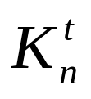
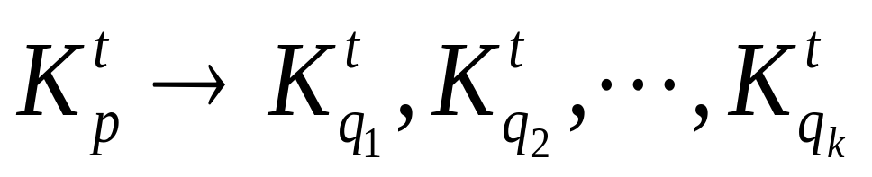
More general form
Let denote the collection of all subsets of t elements of a set of n elements. Given integers t ≥ 2 and integers q₁, q₂, …., q_{k} ≥ t, there exists an integer p such that
r_{t}(q₁, q₂,…,q_{k})
r₁(q₁, q₂,…,q_{k}) = q₁+ q₂+…+q_{k}-k+1 ?

Slide 30

Assignments
Show that if n+1 distinct integers are chosen from the set {1, 2, …, 3n}, then there are always two which differ by at most 2.
Prove that of any five points chosen within a square of side length 1, there are two whose distance apart is at most .
In a room there are 10 people with integer ages [1, 60]. Prove that we can always find two groups of people (with no common person) the sum of whose ages is the same.

